Slide 1
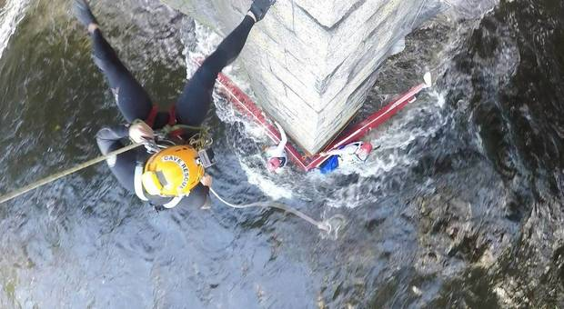
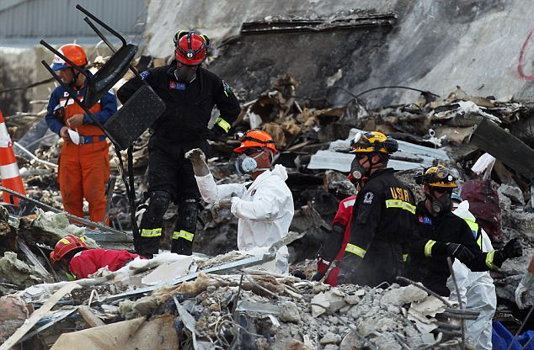
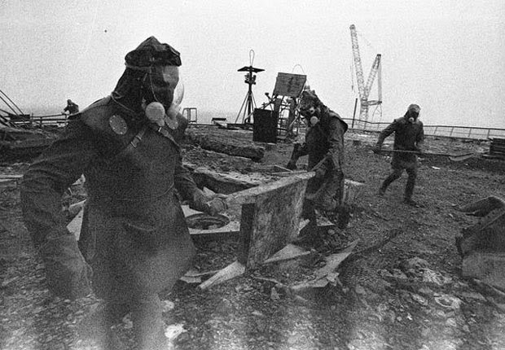
Search and Rescue Operations are Risky
The ‘radiation streaks’are visible!
Notes:
Image 1: https://www.independent.ie/irish-news/dramatic-moment-scouts-rescue-two-paddlers-after-boat-crashes-in-dangerous-flood-waters-31576110.html
Image 2: http://www.dailymail.co.uk/news/article-1362596/New-Zealand-earthquake-Rescuers-hope-finding-survivors-Christchurch-disaster-official-death-toll-hits-161.html
Image 3: https://ohfact.com/interesting-facts-about-chernobyl-nuclear-disaster/

Slide 2
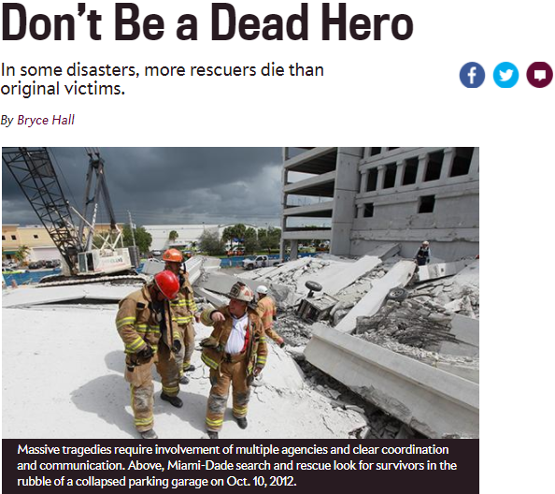
Too Often, Rescuers become Victims
Notes:
Image 1: http://www.slate.com/articles/health_and_science/science/2013/05/rescuers_turning_into_victims_lessons_from_first_responders_on_saving_people.html

Slide 3
The utility of search-and-rescue robots is evident

Slide 4

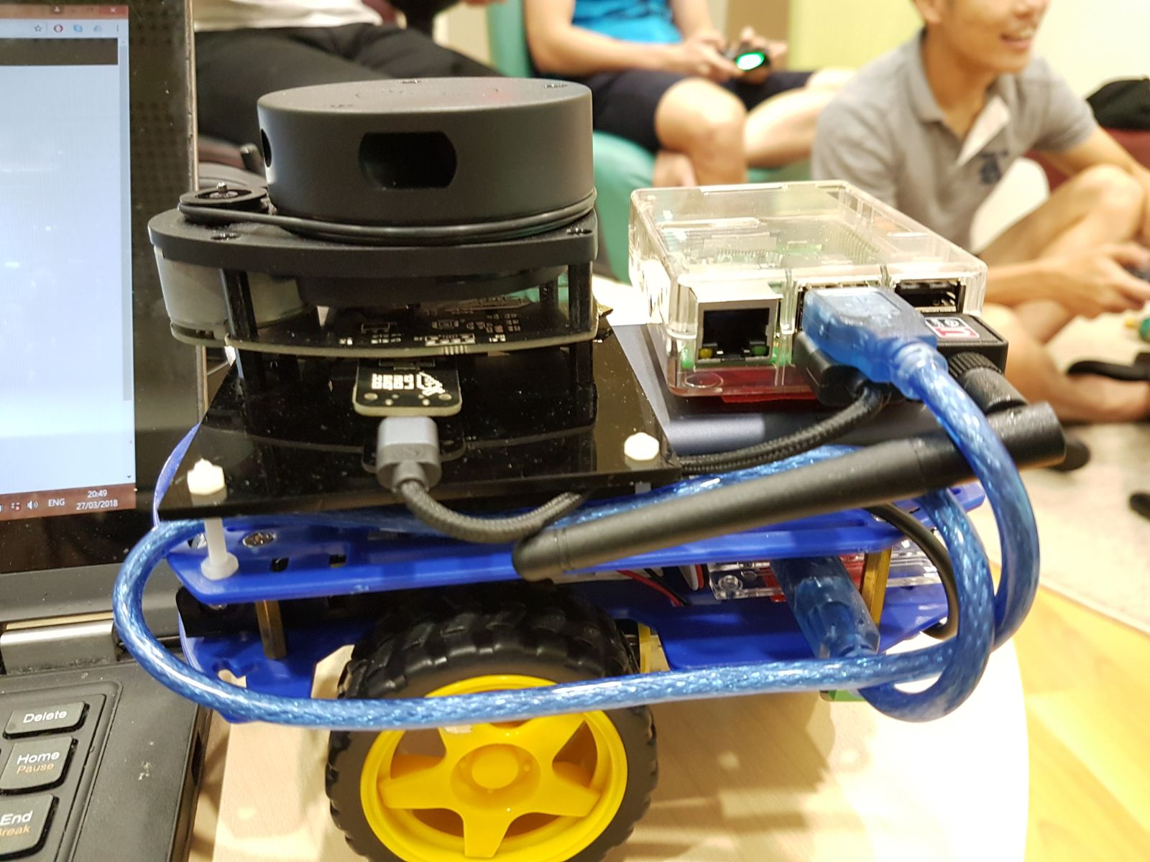
Vincent: To the Rescue!
A presentation by Saif, KP, Pham, and Paras

Slide 5
Overview of Presentation
The State of the Art
(KP)
System Functionalities
(Paras)
System Architecture
(Pham)
Algorithm Design
(Saif)

Slide 6
Review State Of The Art

Slide 7
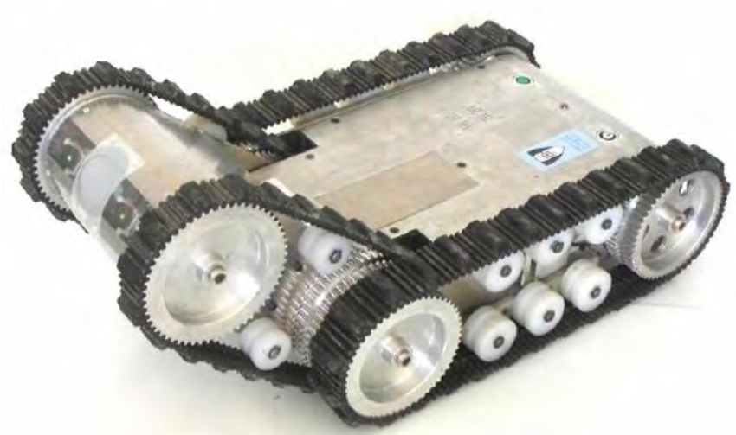
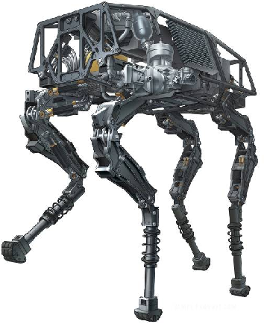
There are two broad categories of search & rescue robotic platforms.
THE RAPOSA
TELE-OPERATING ROBOT
ROBOT BIGDOG
AUTONOMOUS ROBOT
Notes:
Images from https://www.researchgate.net/publication/221065506_RAPOSA_Semi-autonomous_robot_for_rescue_operations

Slide 8
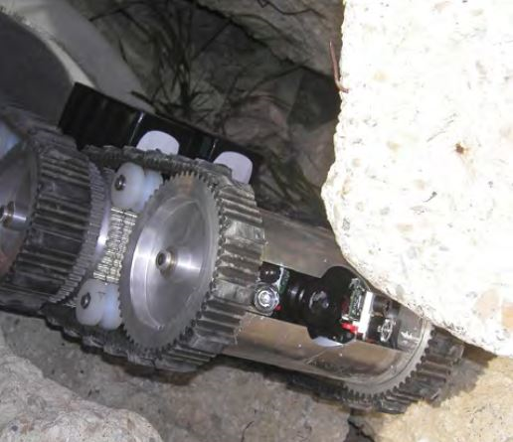
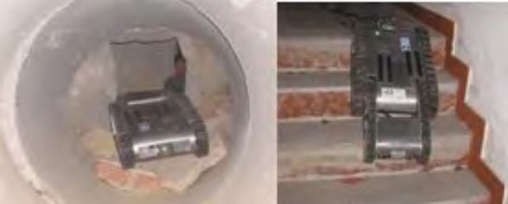
The Roposa can search and rescue survivors in hostile environments.
ROPOSA MOVING THROUGH RUBBLE
ROPOSA MOVING THROUGH A PIPE AND DOWN THE STAIRS
Notes:
RAPOSA images from https://www.researchgate.net/publication/221065506_RAPOSA_Semi-autonomous_robot_for_rescue_operations

Slide 9
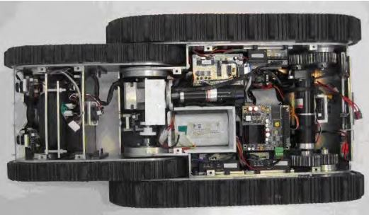
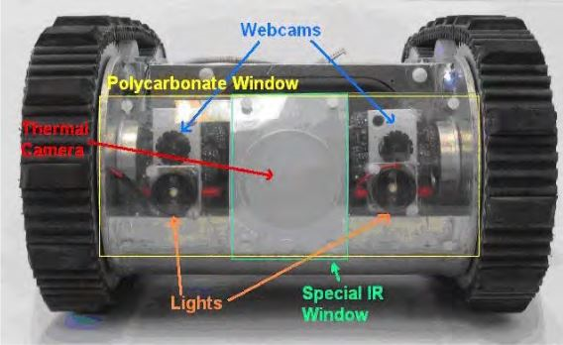
Mechanical structure with sensors and hardware components
AN INSIDE VIEW
THERMAL AND WEB CAMERAS, LIGHTS, IR SENSORS
Notes:
Images from https://www.researchgate.net/publication/221065506_RAPOSA_Semi-autonomous_robot_for_rescue_operations

Slide 10
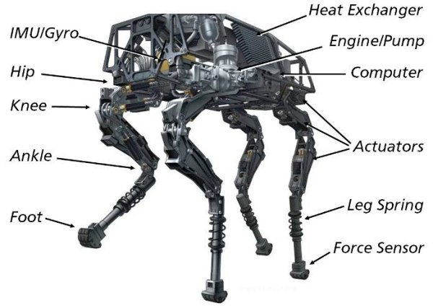
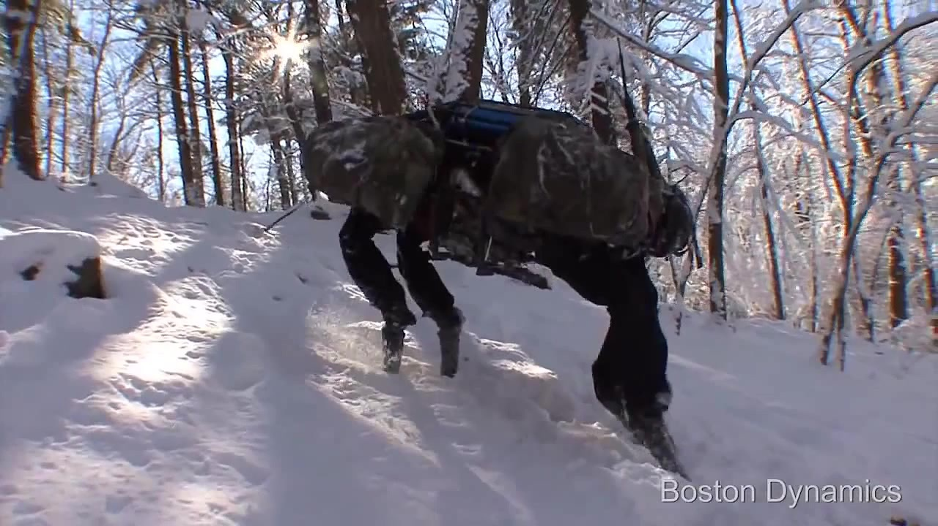
BigDog components and movement in harsh terrain
BIGDOG-COMPONENTS
HARSH TERRAIN- SNOW CAPPED HILLS
Notes:
Images from bostondynamics.com

Slide 11
System Functionalities

Slide 12
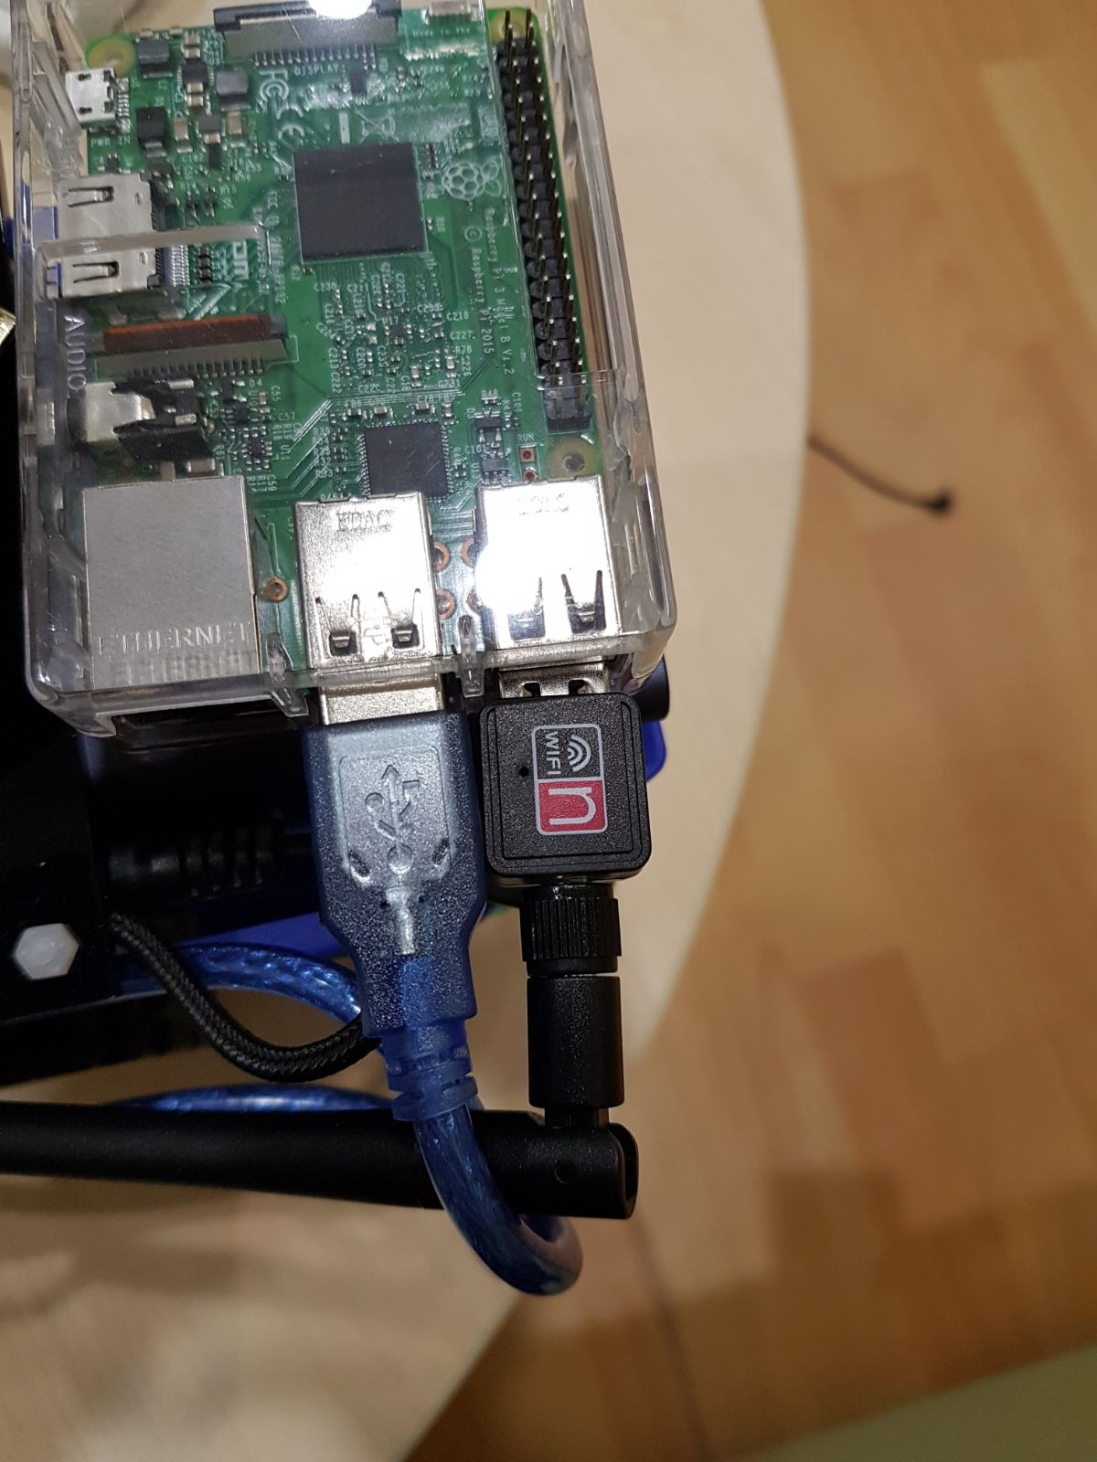
Vincent supports wireless control

Slide 13
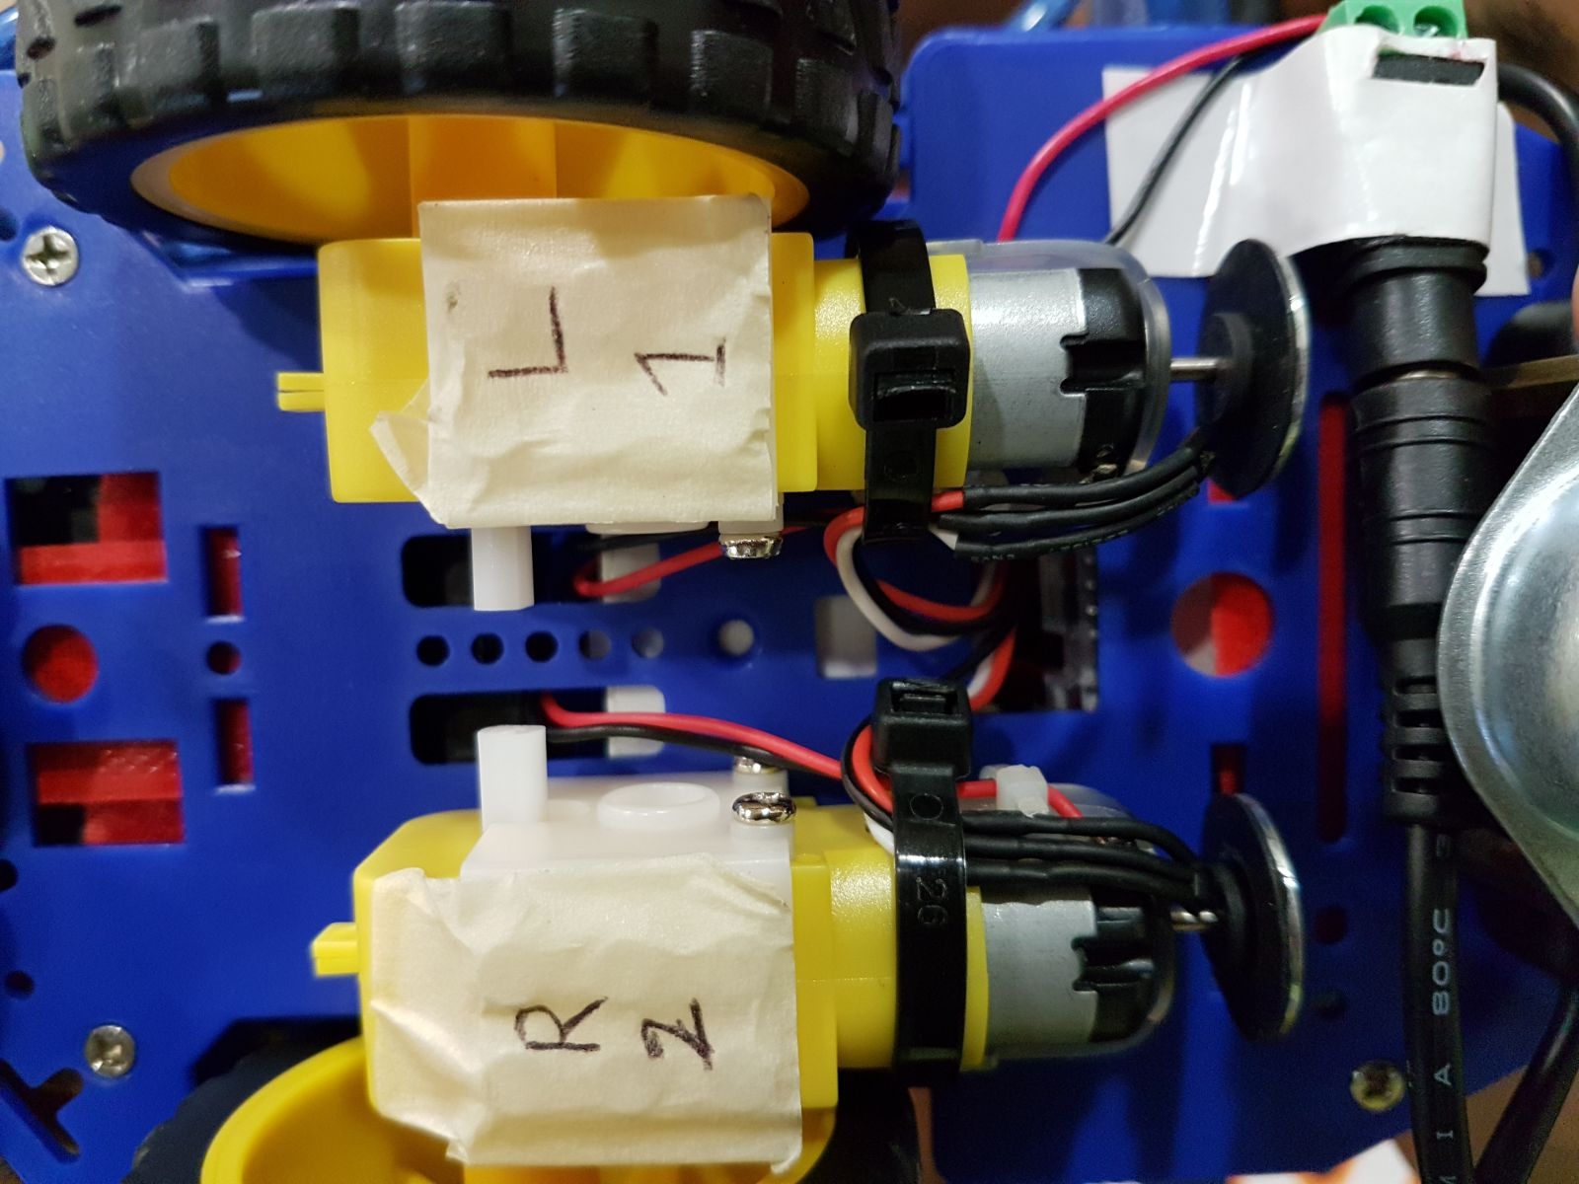
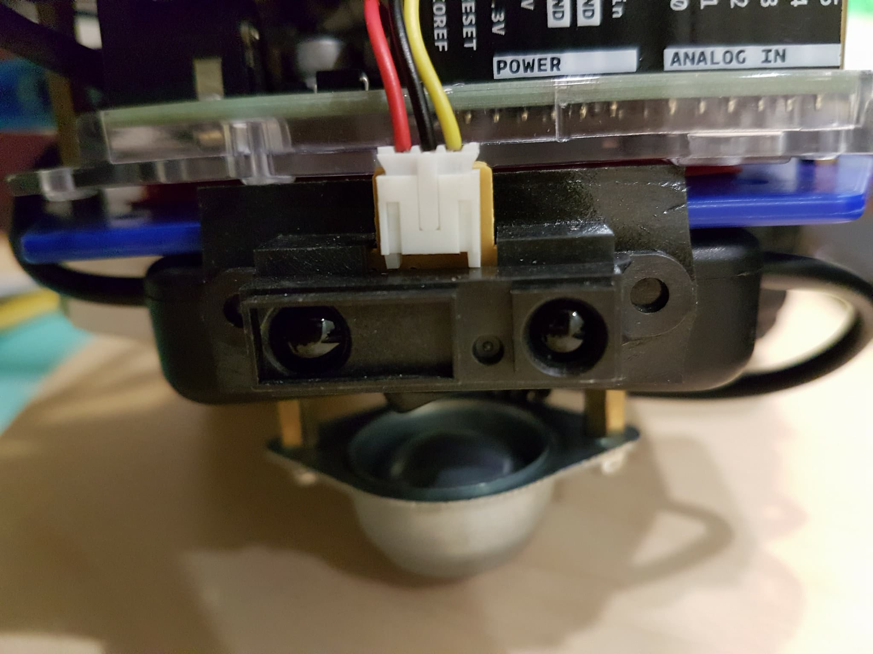
Vincent is capable of accurate 2D motion

Slide 14
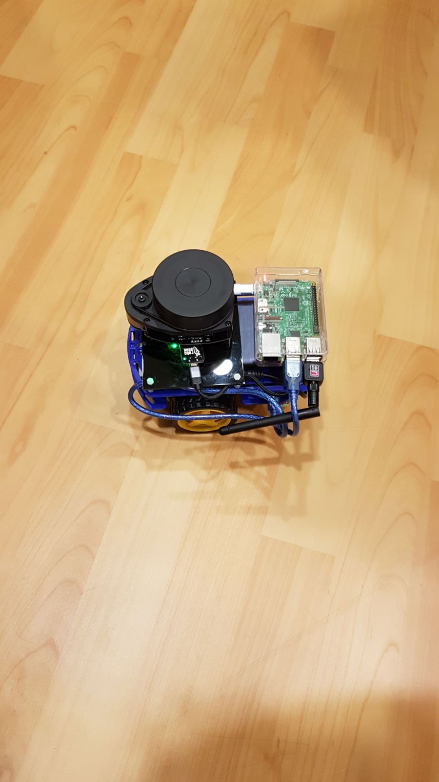
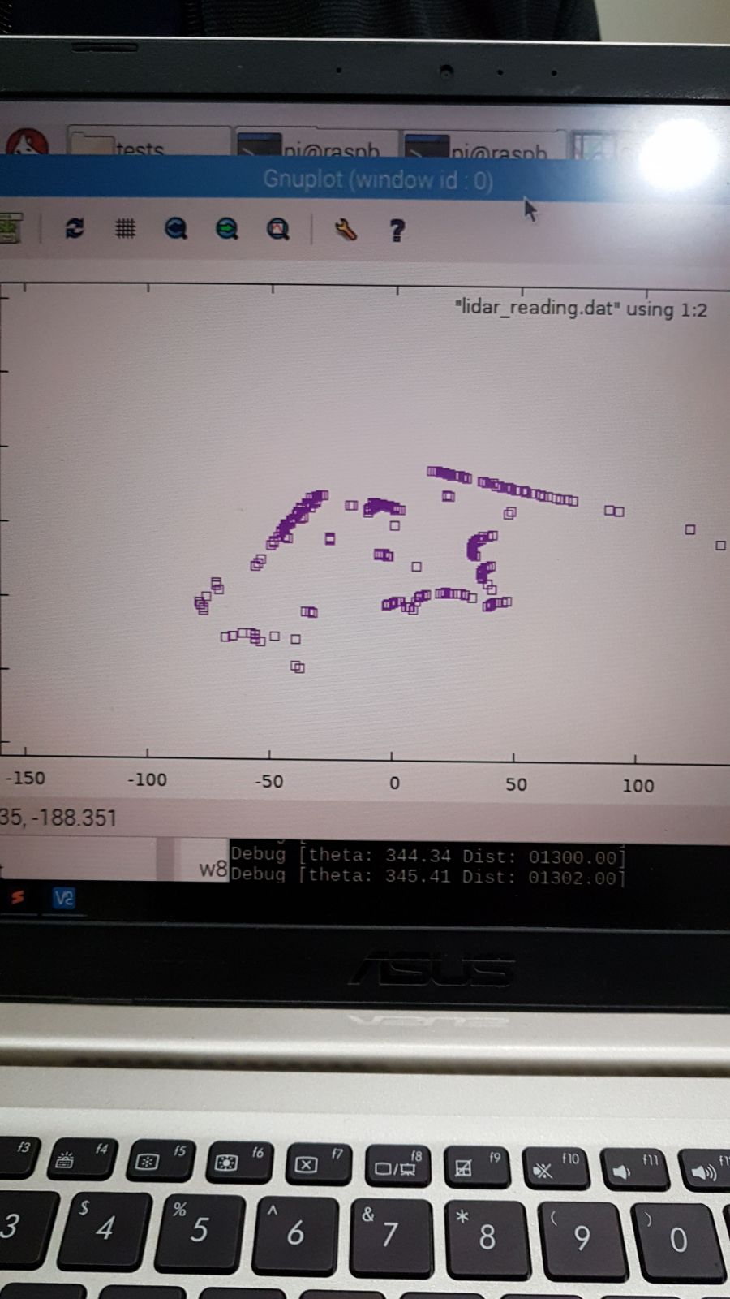
Vincent can map its 2D environment

Slide 15
Vincent can autonomously backtrack to previous positions

Slide 16
System Architecture & Design

Slide 17
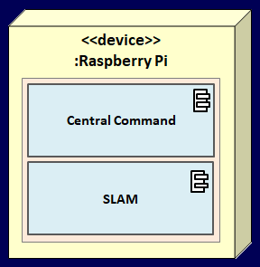
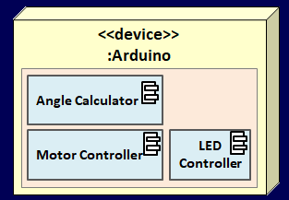
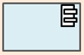
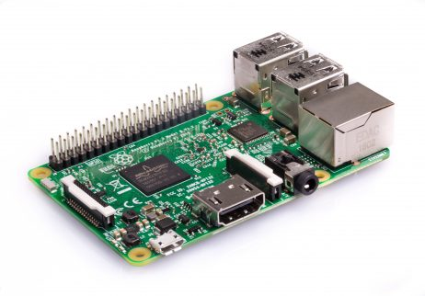
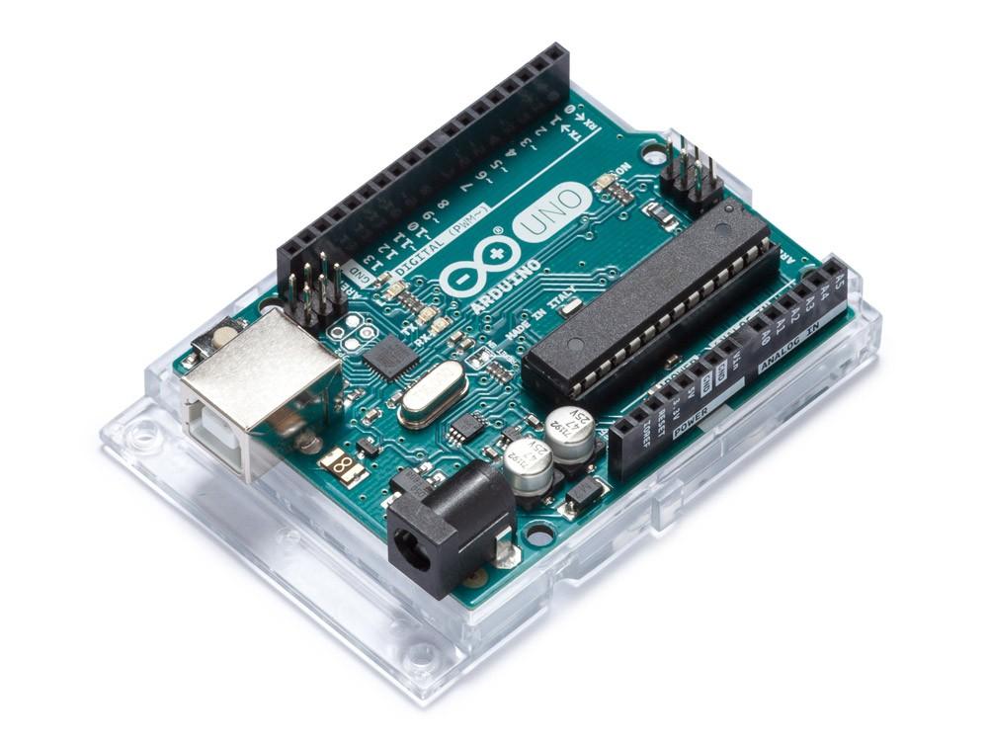
Vincent is powered by a Raspberry Pi & an Arduino Uno
Command
Avoid Wall
Data
Notes:
Image 1: https://store.arduino.cc/arduino-uno-rev3
Image 2: https://uae.souq.com/ae-en/arduino-uno-r3-6186780/i/

Slide 18

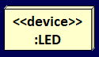
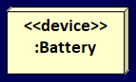
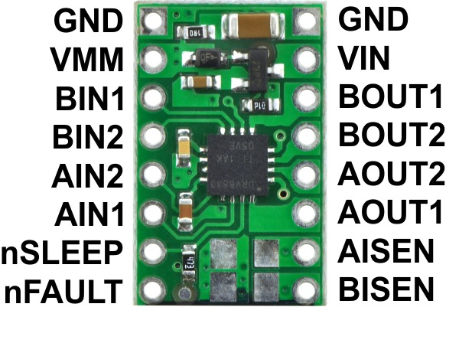
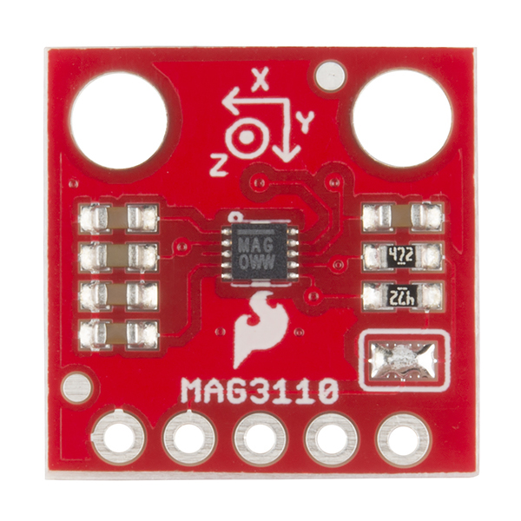
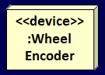
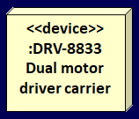
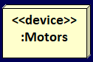
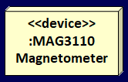
The Arduino Uno is connected to motors & sensors
Command
Avoid Wall
Data
:IR sensors
Data
Power
Data
PWM
Power
PWM
Data
Notes:
Image 1: http://www.hobbytronics.co.uk/drv8833-motor-driver
Image 2: https://www.sparkfun.com/products/12670

Slide 19
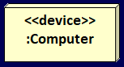
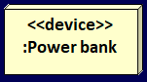
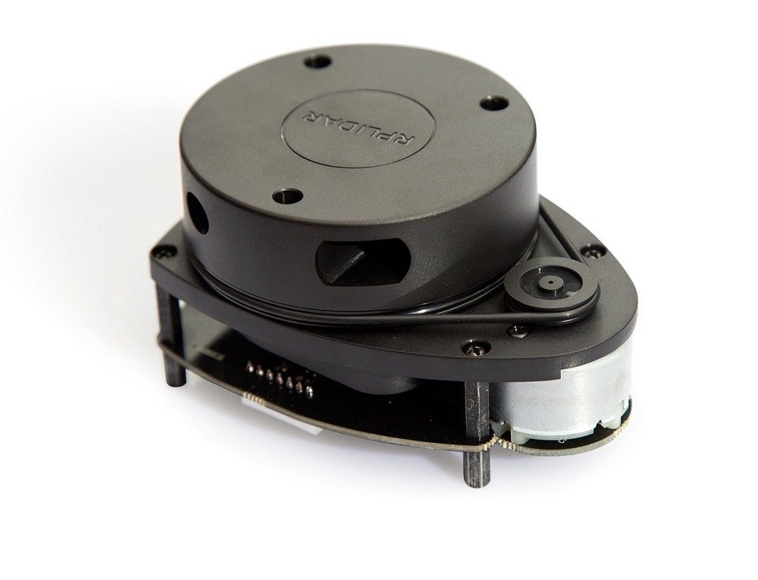
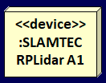
The Raspberry Pi is the brain of Vincent
Client
Server
Wireless connection
Command
Avoid Wall
Data
Power
Data
Notes:
Image 1: https://www.amazon.com/RPLIDAR-A1M8-Degree-Scanner-Development/dp/B00LGC2CTI

Slide 20
Implementation

Slide 21
Initialization
Vincent has three stages of operation
Navigation
Backtracking

Slide 22
INITIALIZING...
Hello Arduino!
Server: Listening...
Server: AiuadslwiB
Server: Passphrase
Server: Listening...
Client: Passphrase
Client: AiuadslwiB
Vincent’s brain
(PI)
Hello PI!
Vincent
Admin
Once trusted, Vincent is ready to follow orders from the Admin.
Vincent tries to establish a secure connection with the stranger, the Admin.
Vincent’s nervous system
(Arduino)
Vincent’s brain and nervous system exchange a ‘Hello!’

Slide 23



During Navigation Phase executes Admin commands to complete the maze
Forward Backward
Right
Left Mark Undo Insert
End
Psst, kid. Wanna buy some phamSlamTM?
commandStack
F, 50, 100

Slide 24

During Navigation Phase executes Admin commands to complete the maze
Vincent pops off the stack while Backtracking
Insert M!
END!
UNDO!
Forward Backward
Right
Left Mark Undo Insert
End
DONE!
M, 0, 0
commandStack
F, 70, 100
Stack.empty()
R, 90, 100
F, 50, 100

Slide 25
Conclusion

Slide 26
Thank you

